Slide 1
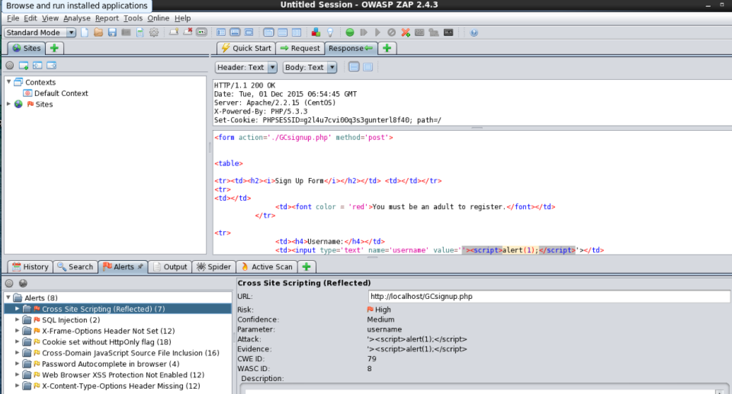
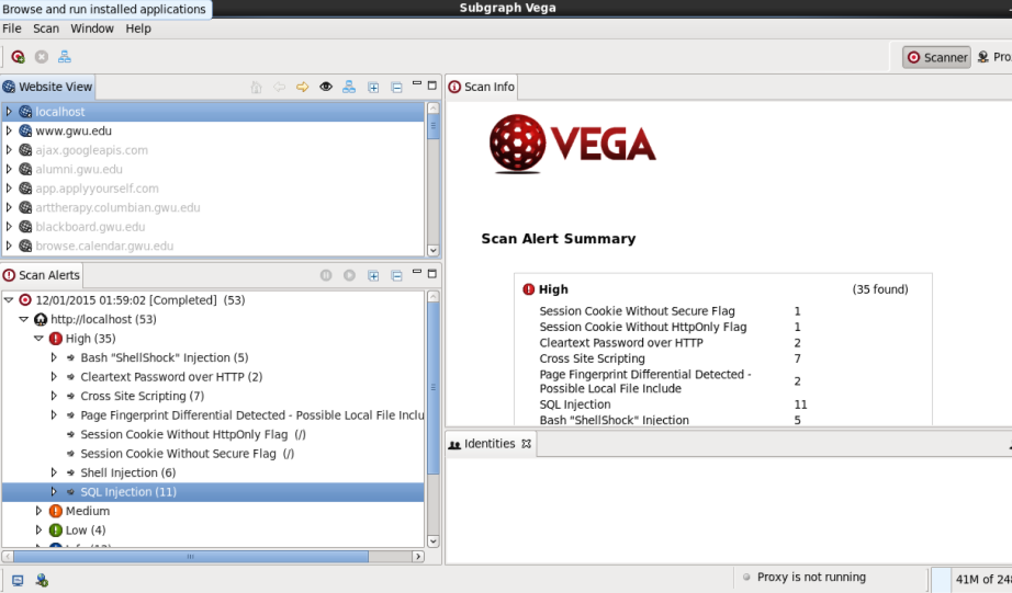
ZAP & Vega

Slide 2
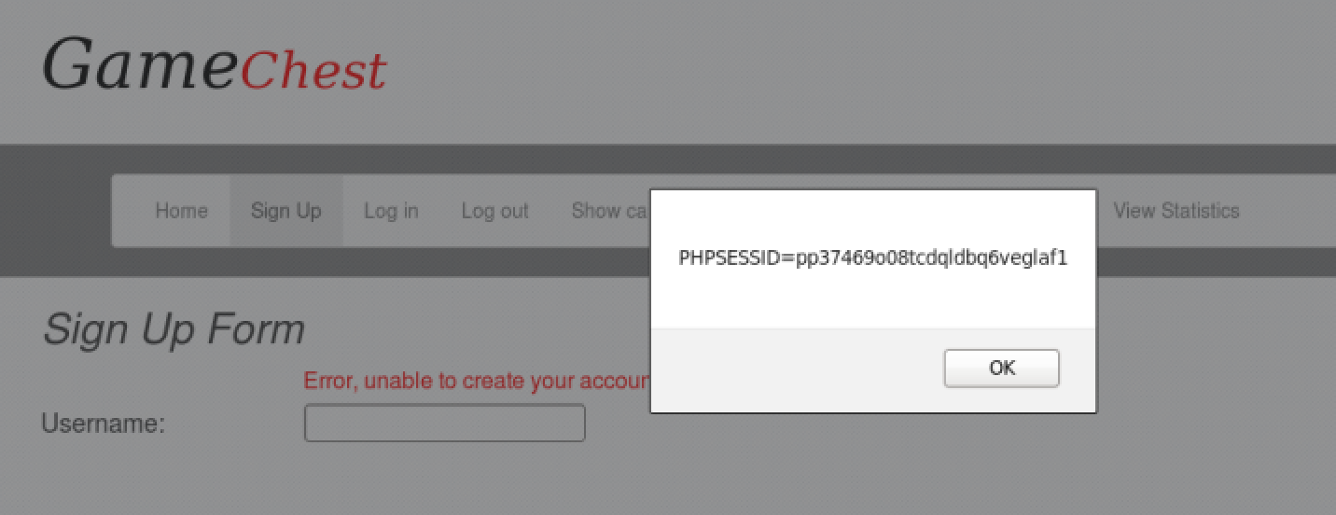
Cross-Site Scripting (XSS)
Test each input field in the login page and signup page with the following input:
‘><script>alert(document.cookie)</script>

Slide 3
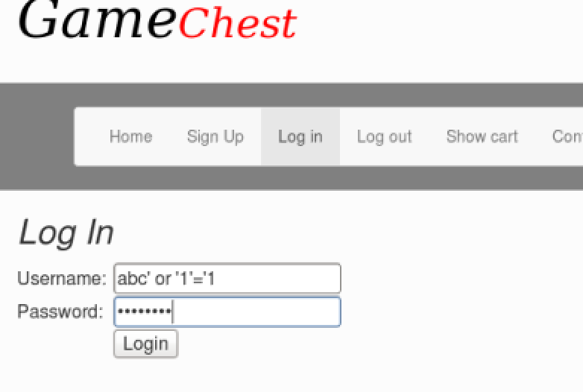
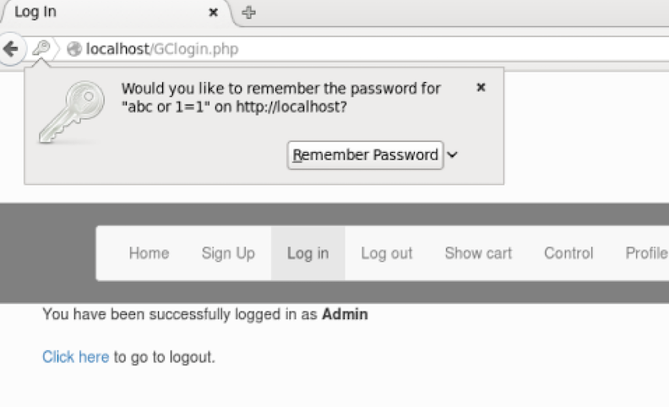
SQL Injection

Slide 4
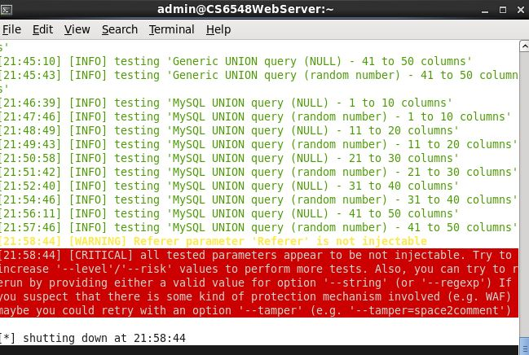
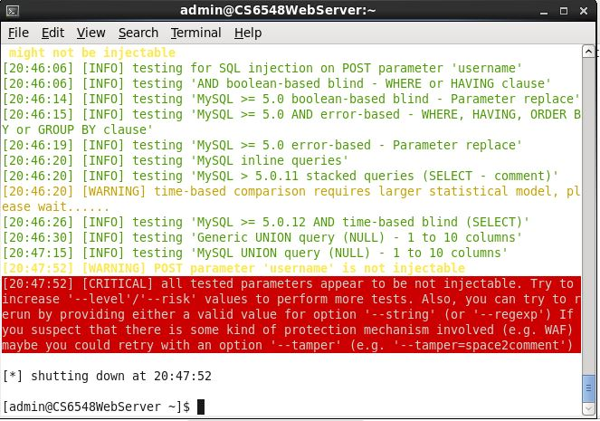
Automated SQL Injection (GET, POST)

Slide 5
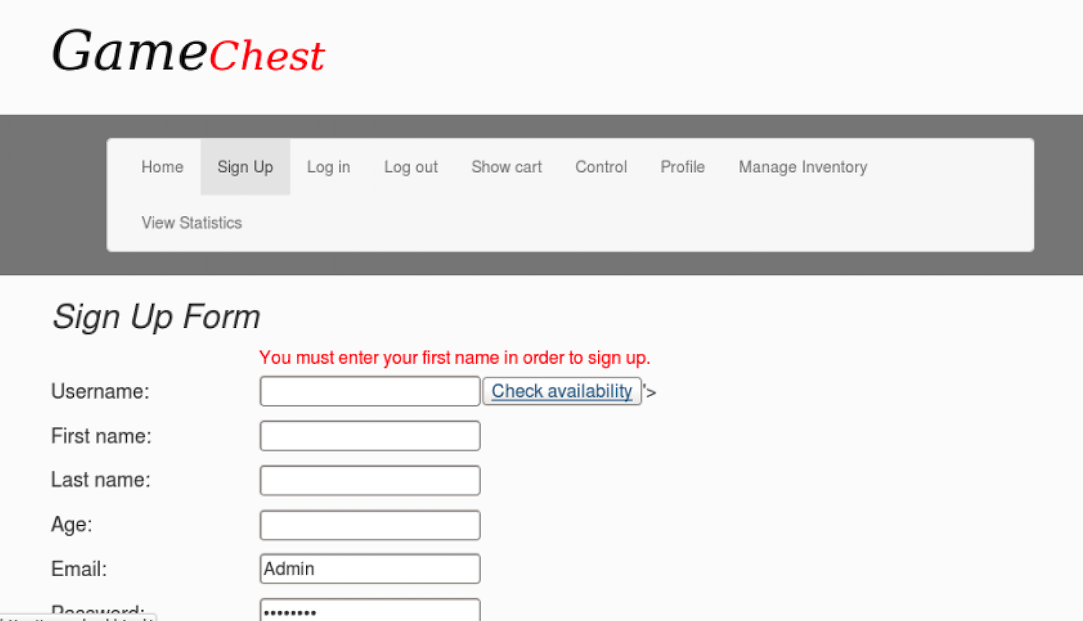
Clickjacking

Slide 6
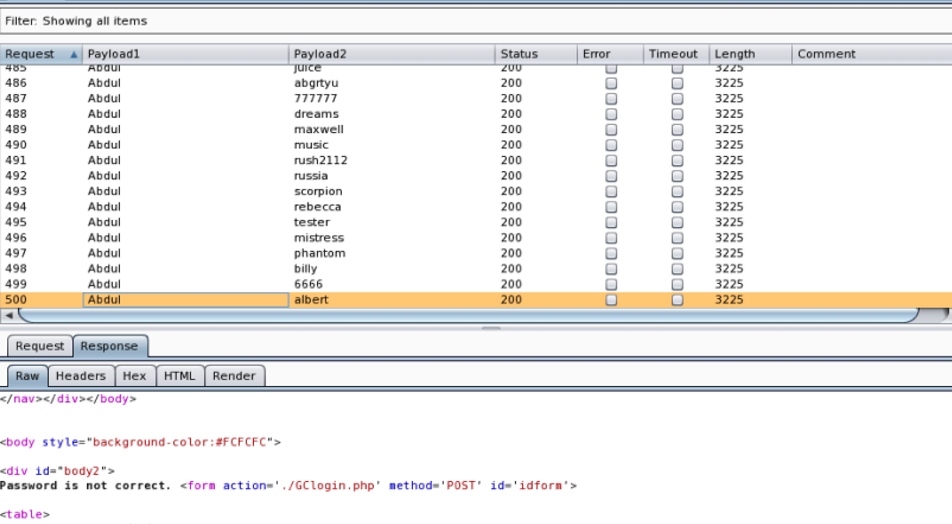
Brute Force Login Credentials

Slide 7
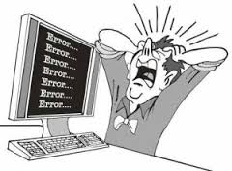
Other Vulnerabilities
Credit card checkout does not require valid username and expiration date
Session vulnerabilities exists, but needed to be explored.

